Slide 1
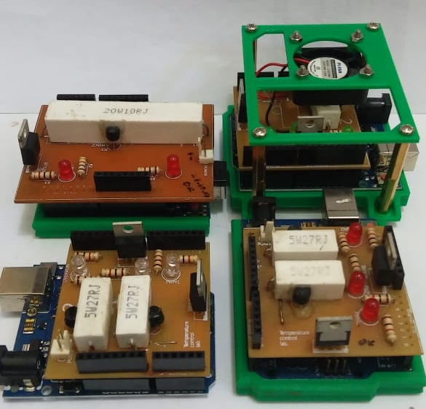
Energy Balance Model for the Universitas Pertamina Temperature Control Device

Slide 2
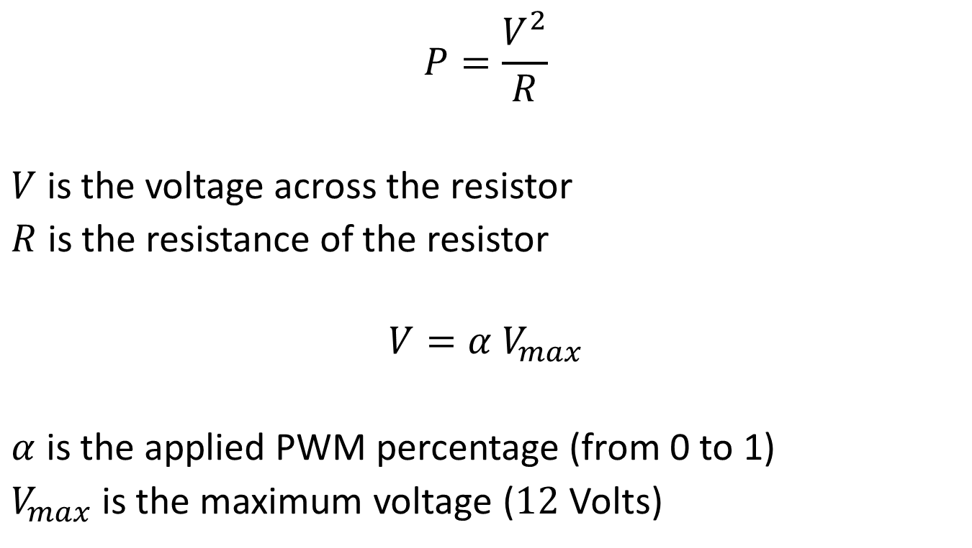
Heat Dissipated by a Resistor
$$P=\frac{V^{2}}{R}$$
$V$ is the voltage across the resistor
$R$ is the resistance of the resistor
$$V=α V_{max}$$
$α$ is the applied PWM percentage (from 0 to 1)
$V_{max}$ is the maximum voltage ($12$ Volts)

Slide 3
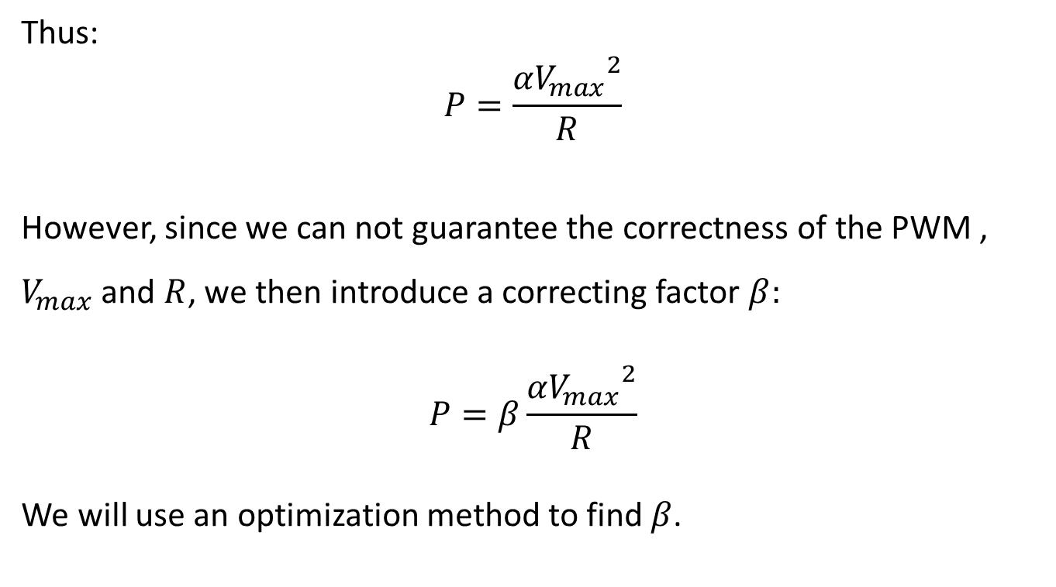
Heat Dissipated by a Resistor
Thus:
$$P=\frac{{{αV}_{max}}^{2}}{R}$$
However, since we can not guarantee the correctness of the PWM , $V_{max}$ and $R$, we then introduce a correcting factor $β:$
$$P=β\frac{{αV_{max}}^{2}}{R}$$
We will use an optimization method to find $β$.

Slide 4
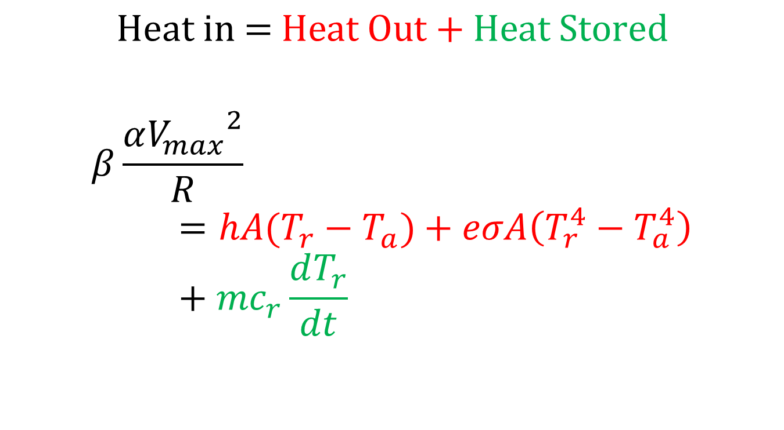
Energy Balance Model
$$\text{Heat} \text{in}\text{ = }\text{Heat} \text{Out}\text{ + }\text{Heat} \text{Stored}$$
$$β\frac{{αV_{max}}^{2}}{R}=hA(T_{r}−T_{a})+eσA\left(T_{r}^{4}−T_{a}^{4}\right)+{mc}_{r}\frac{dT_{r}}{dt}$$

Slide 5
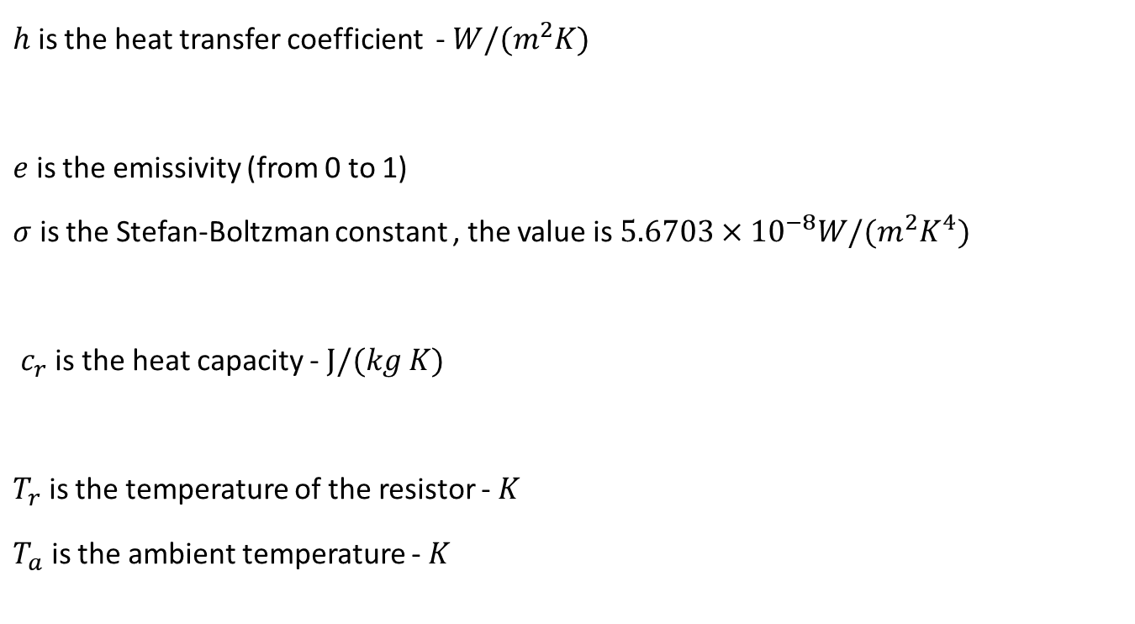
Energy Balance Model
$h$ is the heat transfer coefficient - $W/(m^{2}K)$
$e$ is the emissivity (from 0 to 1)
$σ$ is the Stefan-Boltzman constant , the value is $5.6703×{10}^{−8}W/(m^{2}K^{4})$
$c_{r}$ is the heat capacity - $J/(kg K)$
$T_{r}$ is the temperature of the resistor - $K$
$T_{a}$ is the ambient temperature - $K$

Slide 6
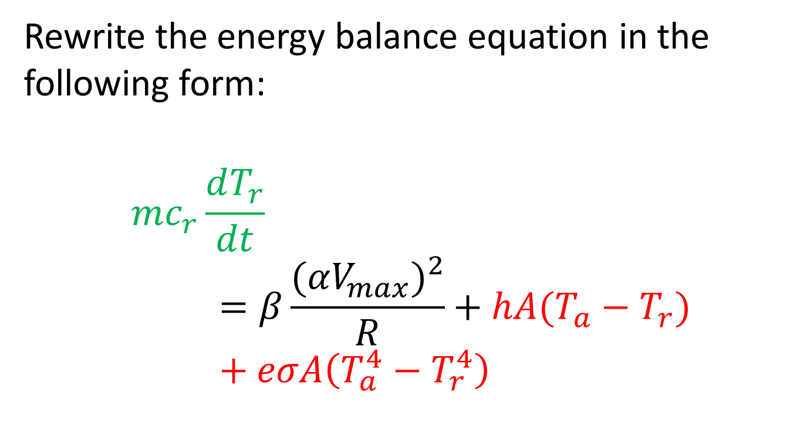
Finding the Unknown Parameters
Rewrite the energy balance equation in the following form:
$$mc_{r}\frac{dT_{r}}{dt}=β\frac{{(αV_{max})}^{2}}{R}+hA(T_{a}−T_{r})+eσA\left(T_{a}^{4}−T_{r}^{4}\right)$$

Slide 7
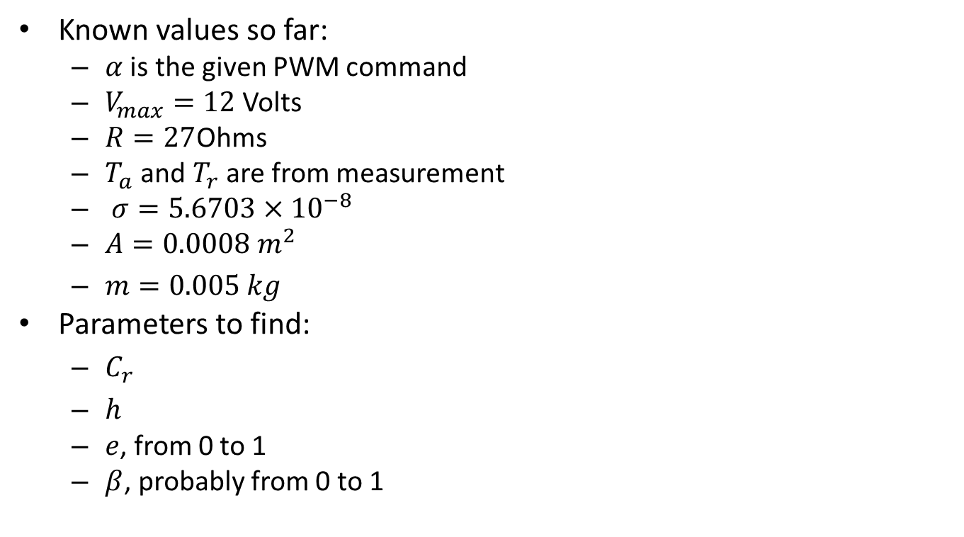
Finding the Unknown Parameters
Known values so far:
$α$ is the given PWM command
$V_{max}=12$ Volts
$R=27$Ohms
$T_{a}$ and $T_{r}$ are from measurement
$σ=5.6703×{10}^{−8}$
$A=0.0008 m^{2}$
$m=0.005 kg$
Parameters to find:
$C_{r}$
$h$
$e$, from 0 to 1
$β$, probably from 0 to 1
More or less, measured with a ruler and a scale.

Slide 8
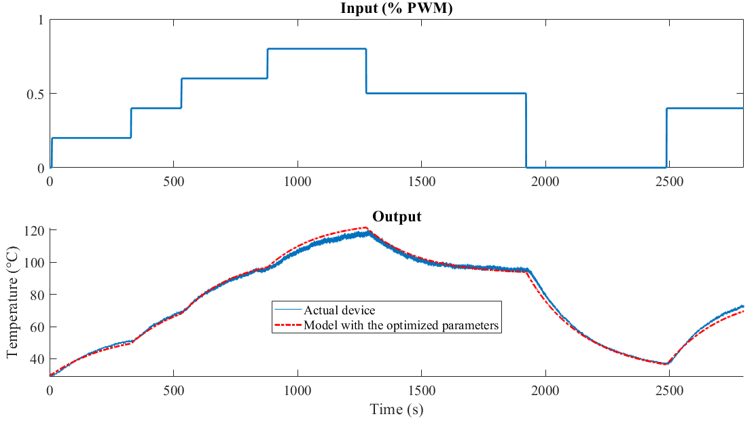
Results

Slide 9
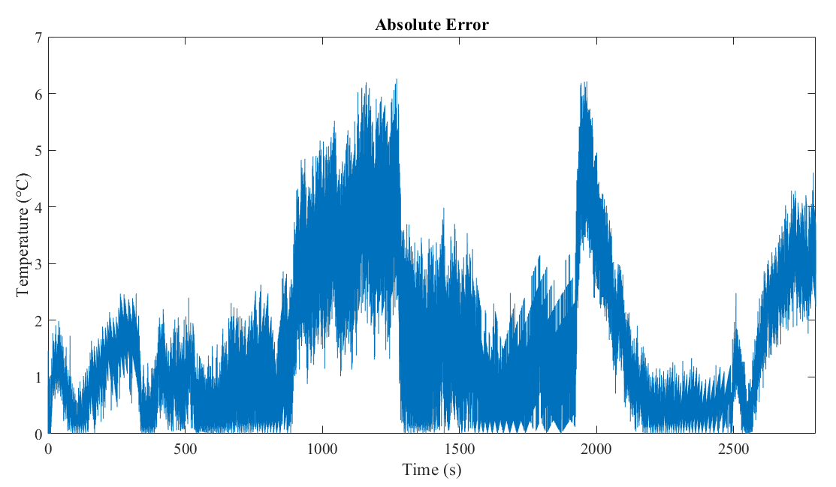
Results

Slide 10
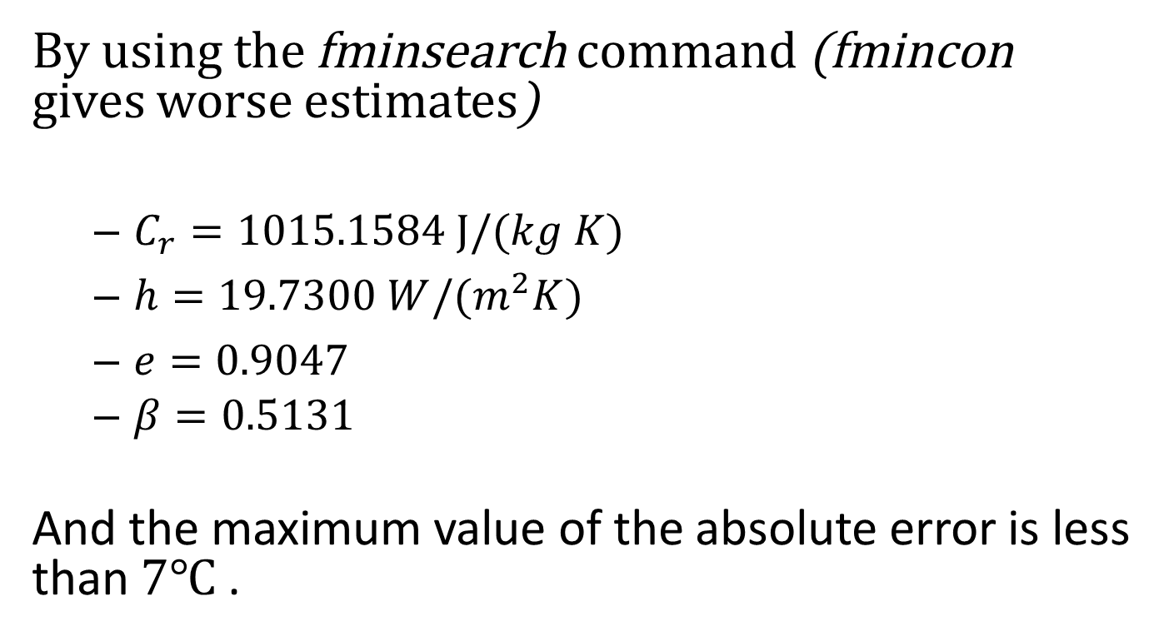
Results
By using the fminsearch command (fmincon gives worse estimates)
$C_{r}=1015.1584 J/(kg K)$
$h=19.7300 W/(m^{2}K)$
$e=0.9047$
$β=0.5131$
And the maximum value of the absolute error is less than $7℃$.

Slide 11

Results
Seriously, no time delay?
Why?

Slide 12
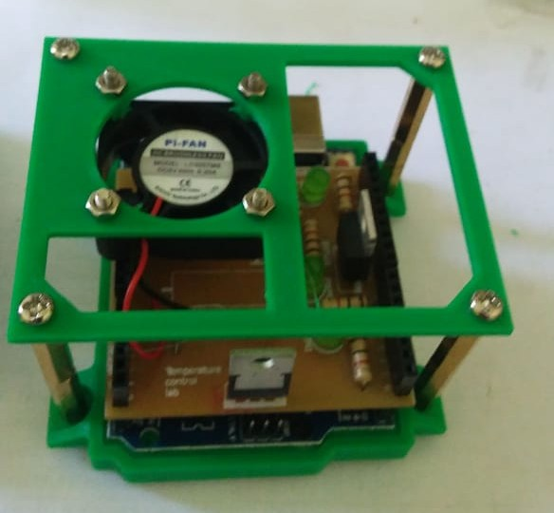
Modeling Heat Transfer Coefficient by the Fan
Small fan on top the heater. The speed of the fan can be adjusted,
from 0 (no speed) to 1 (full speed).

Slide 13
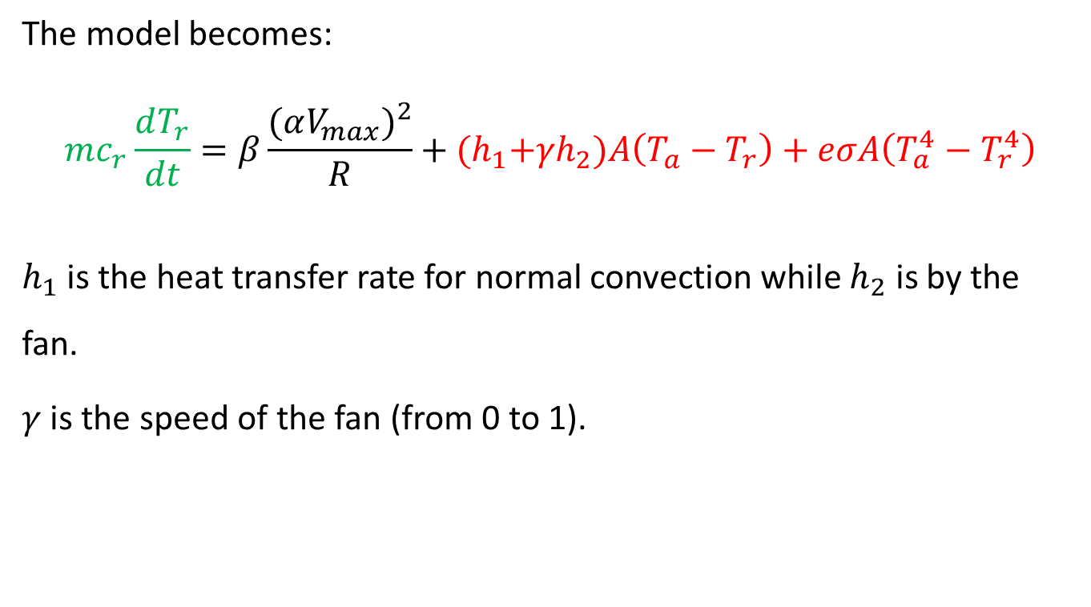
Energy Balance Model
The model becomes:
$$mc_{r}\frac{dT_{r}}{dt}=β\frac{{(αV_{max})}^{2}}{R}+{(h}_{1}+{γh}_{2})A\left(T_{a}−T_{r}\right)+eσA\left(T_{a}^{4}−T_{r}^{4}\right)$$
$h_{1}$ is the heat transfer rate for normal convection while $h_{2}$ is by the fan.
$γ$ is the speed of the fan (from 0 to 1).

Slide 14
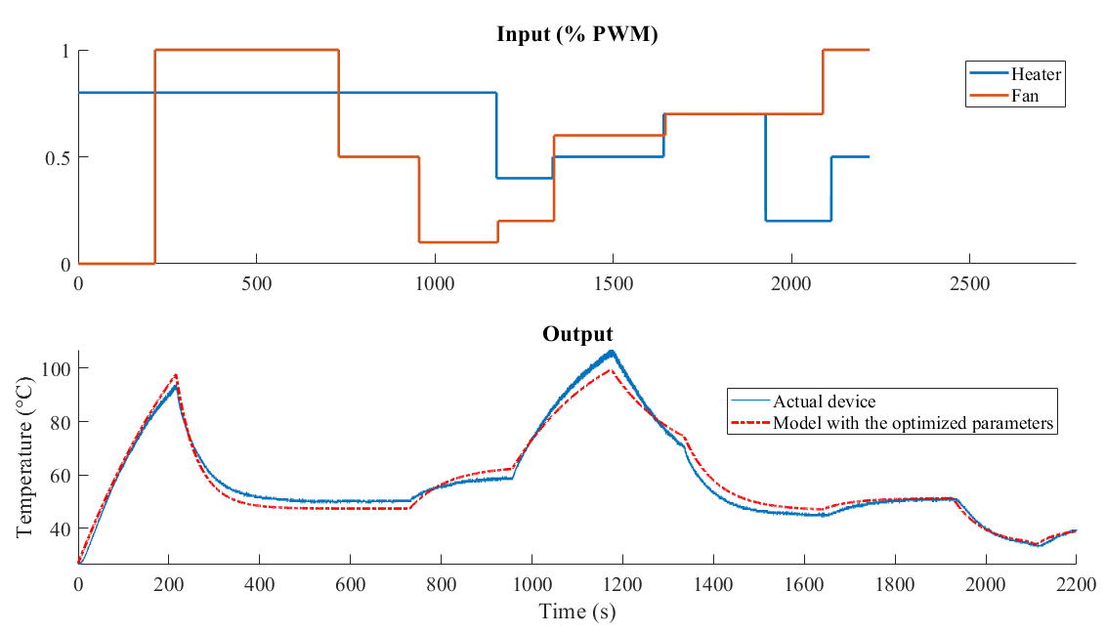
Results

Slide 15
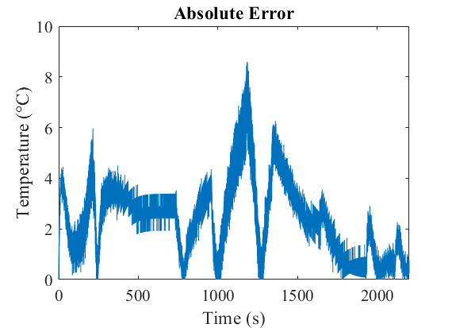
Results

Slide 16
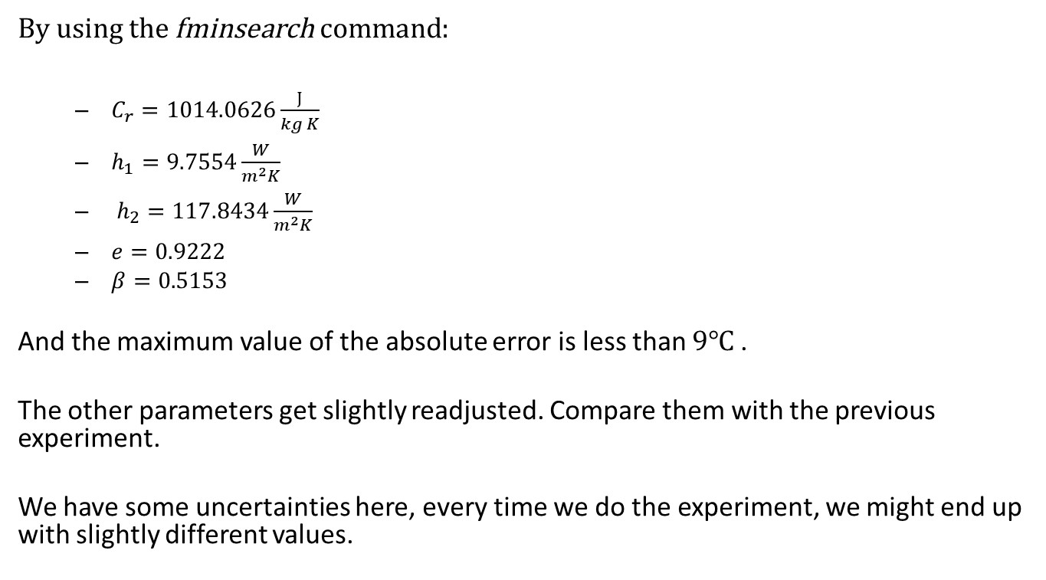
Results
By using the fminsearch command:
$C_{r}=1014.0626\frac{J}{kg K}$
$h_{1}=9.7554\frac{W}{m^{2}K}$
$h_{2}=117.8434\frac{W}{m^{2}K}$
$e=0.9222$
$β=0.5153$
And the maximum value of the absolute error is less than $9℃$.
The other parameters get slightly readjusted. Compare them with the previous experiment.
We have some uncertainties here, every time we do the experiment, we might end up with slightly different values.

